Slide 1

Credit Card Fraud Detection Using Logistic Regression, SVM and Isolation Forest
COURSE : Machine learning
COURSE CODE: 25SC2107E
SECTION: 4
Branch: CSE
GUIDED BY: JYOTHSNA DATTI(Assistant professor)
2520030157 - SAI SURENDRANATH PENDYALA
2520030325 – VANAPALLI ABHIDEV
2026-2027

Slide 2
CONTENTS
ABSTRACT
INTRODUCTION
REQUIREMENT ANALYSIS
20 LITERATURE PAPERS IN TABLE FORMAT
DATASET DESCRIPTION
PROBLEM STATEMENT AND OBJECTIVE
EDA OUTPUT
METHODOLOGY
RESULTS – COMPARISON TABLES WITH PRECISION,RECALL,F1 SCORE,ACCURACY
RESULTS – GRAPHS
DISCUSSION
CONCLUSION
FUTURE SCOPE

Slide 3
ABSTRACT
Credit card fraud is a major challenge in modern financial systems because fraudulent transactions can cause significant financial losses and reduce customer trust. This project, “Credit Card Fraud Detection Using Logistic Regression, SVM and Isolation Forest,” aims to develop and compare multiple machine learning approaches for identifying fraudulent credit card transactions. The project will use the publicly available Credit Card Fraud Detection dataset, which contains European cardholder transactions , with a balanced distribution between legitimate and fraudulent transactions. The dataset will be preprocessed and divided into training and testing sets while applying appropriate techniques to handle class imbalance. Three approaches—Logistic Regression, Support Vector Machine (SVM), and Isolation Forest—will be implemented and compared. Logistic Regression provides an interpretable supervised classification baseline, SVM identifies complex decision boundaries between transaction classes, while Isolation Forest provides an unsupervised anomaly-detection approach suitable for identifying unusual transactions. The performance of the proposed models will be evaluated using Accuracy, Precision, Recall, F1-Score, ROC-AUC, and Confusion Matrix, with particular emphasis on Precision, Recall, and F1-Score because fraud datasets are highly imbalanced. The final system will compare the strengths and limitations of each algorithm and determine which approach provides the most reliable fraud detection performance. The project aims to demonstrate how machine learning can support automated financial fraud detection while reducing false alarms and improving the identification of suspicious transactions.

Slide 4
INTRODUCTION
The rapid growth of digital payments, online banking, and credit card transactions has made electronic financial services more convenient and accessible. However, this growth has also increased opportunities for fraudulent activities, including unauthorized transactions and stolen card usage. Detecting fraudulent transactions is challenging because fraudulent events usually represent only a very small proportion of all transactions. A model that simply predicts every transaction as legitimate may achieve high accuracy while failing to detect the transactions that matter most. Therefore, an effective fraud detection system must identify suspicious transactions while maintaining a reasonable balance between detecting fraud and minimizing false alarms. This project, “Credit Card Fraud Detection Using Logistic Regression, SVM and Isolation Forest,” focuses on applying machine-learning techniques to automatically distinguish fraudulent transactions from legitimate ones. The project will use the Credit Card Fraud Detection dataset from the Kaggle. The dataset is balanced using the technique SMOTE(Synthetic Minority Over-sampling Technique). The dataset will be cleaned, normalized where necessary, and divided into suitable training and testing sets. Three different approaches will then be investigated: Logistic Regression as a supervised baseline classifier, Support Vector Machine (SVM) for learning effective classification boundaries, and Isolation Forest for detecting anomalous transactions without requiring fraud labels during anomaly detection. The models will be compared using Accuracy,Precision,Recall,F1-Score,ROC-AUC and Confusion Matrix.

Slide 5
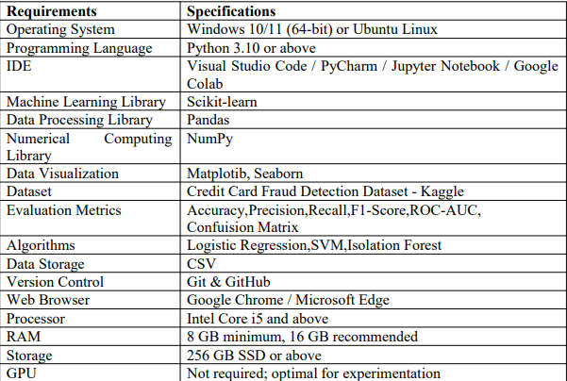
REQUIREMENT ANALYSIS

Slide 6
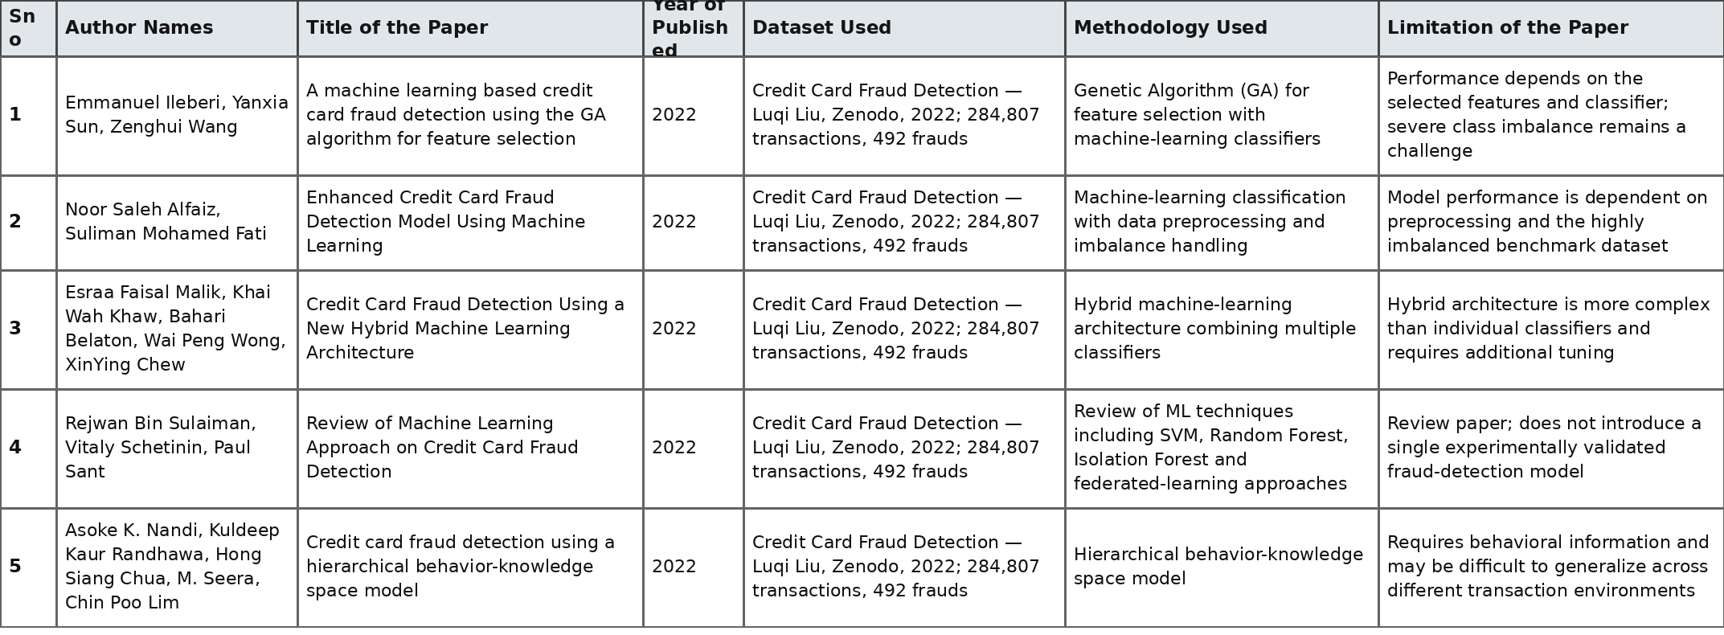
20 Literature papers (1 – 5)

Slide 7
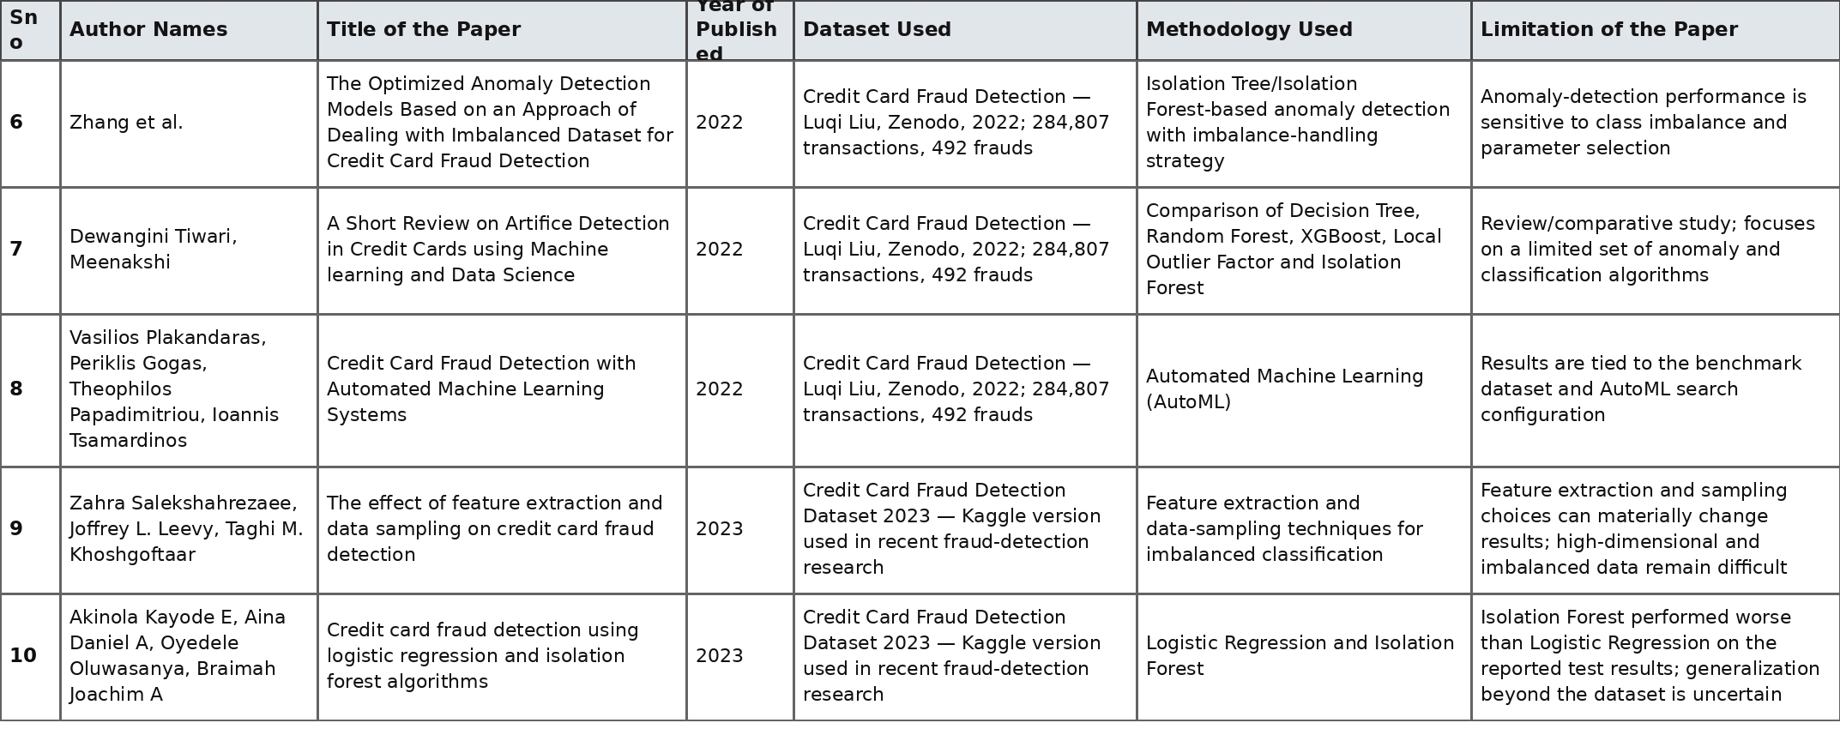
20 Literature papers (6 – 10)

Slide 8
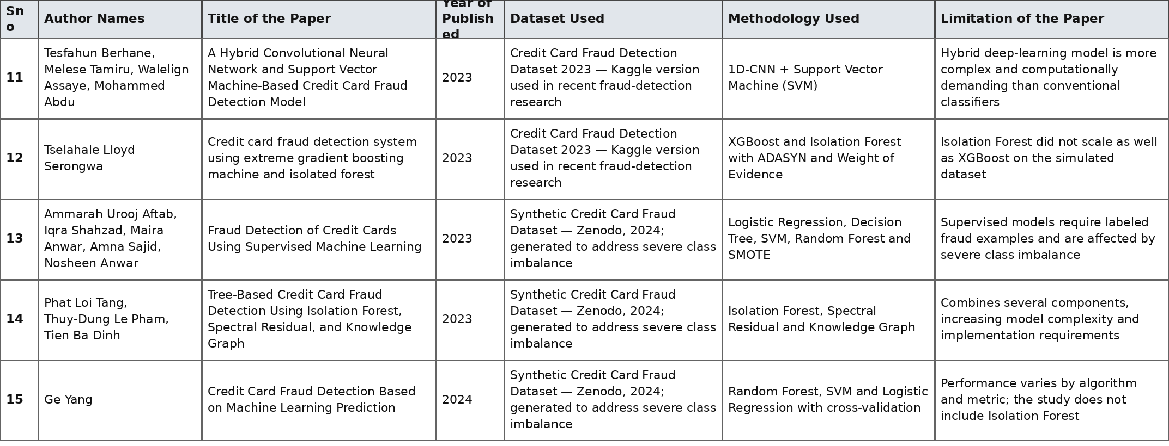
20 Literature papers (11 – 15)

Slide 9
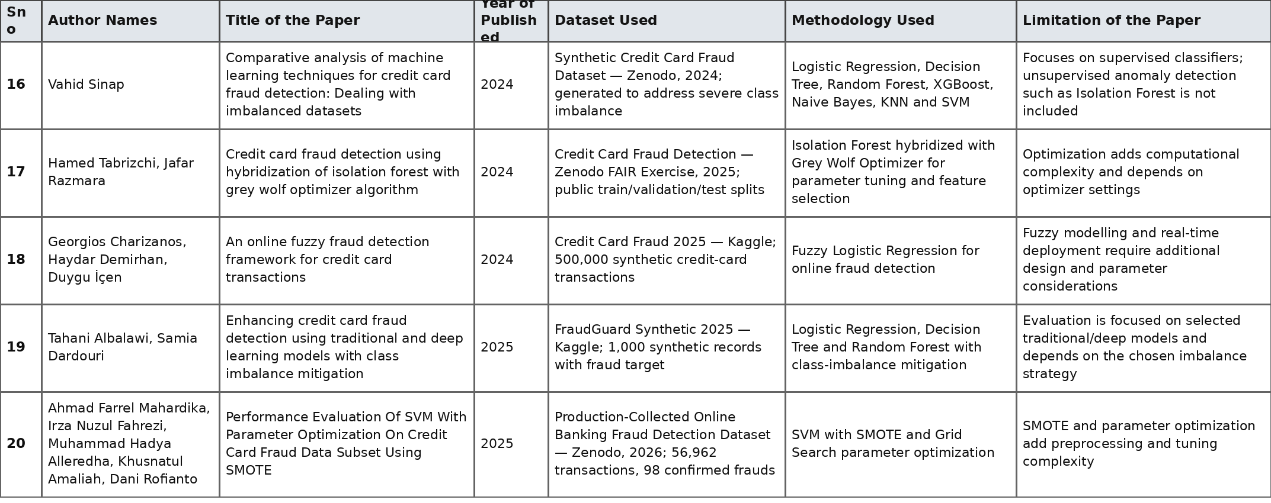
20 Literature papers (16 – 20)

Slide 10
DATASET Description
The Credit Card Fraud Detection dataset used in this project is obtained from Kaggle. The original dataset contains 20,000 transaction records with 26 attributes. To address class imbalance, random under sampling is applied to the majority class. The resulting balanced dataset contains 678 records, consisting of 339 legitimate transactions and 339 fraudulent transactions, giving a 50:50 class distribution. The dataset contains numerical and categorical transaction-related attributes, with fraud as the target variable for binary classification. This dataset can be balanced using a technique SMOTE(Synthetic Minority Over-sampling Technique) analysis.

Slide 11
PROBLEM STATEMENT AND OBJECTIVE
Credit card transactions generate large amounts of data, making manual identification of fraudulent transactions difficult. Fraudulent and legitimate transactions can have similar characteristics, while fraudulent transactions may represent only a small portion of the total transactions. Therefore, an automated machine-learning system is required to identify suspicious transactions and classify them as SAFE or FRAUD.
Objective: Compare Logistic Regression, SVM and Isolation Forest for credit-card fraud detection.

Slide 12
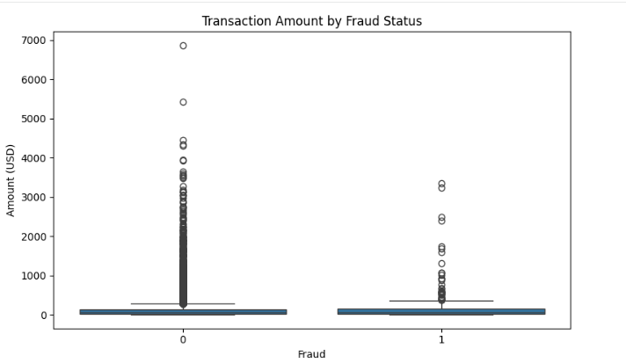
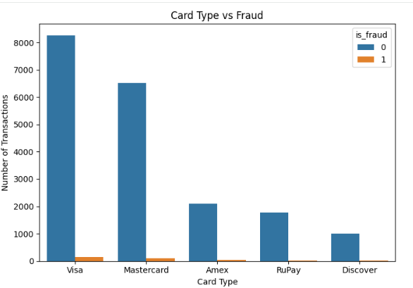
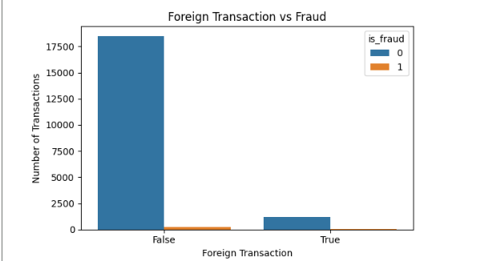
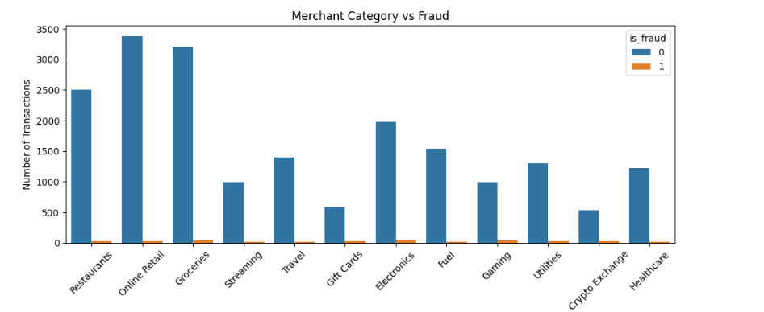
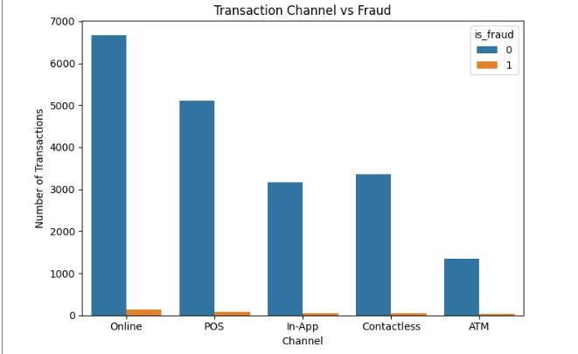
EDA OUTPUT

Slide 13
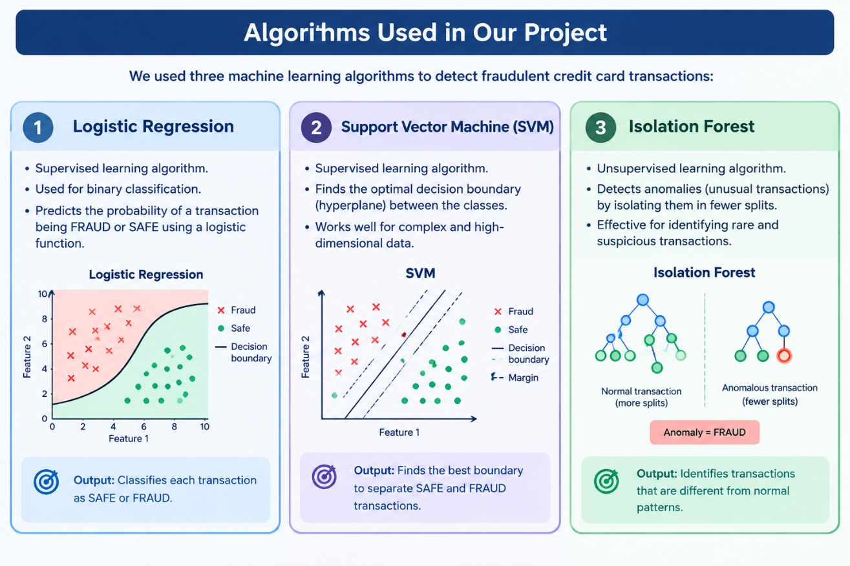
METHODOLOGY

Slide 14
RESULTS – COMPARISON TABLES WITH PRECISION,RECALL,F1 SCORE, ACCURACY, auc-roc
Metric | Logistic Regression | SVM | Isolation Forest
Accuracy | 81.17% | 80.38% | 80.02%
Precision | 10.62% | 11.05% | 34.38%
Recall | 86.83% | 83.25% | 17.75%
F1-Score | 18.07% | 19.41% | 23.2%
AUC-ROC | 92.40% | 92.63% | 94.12%

Slide 15
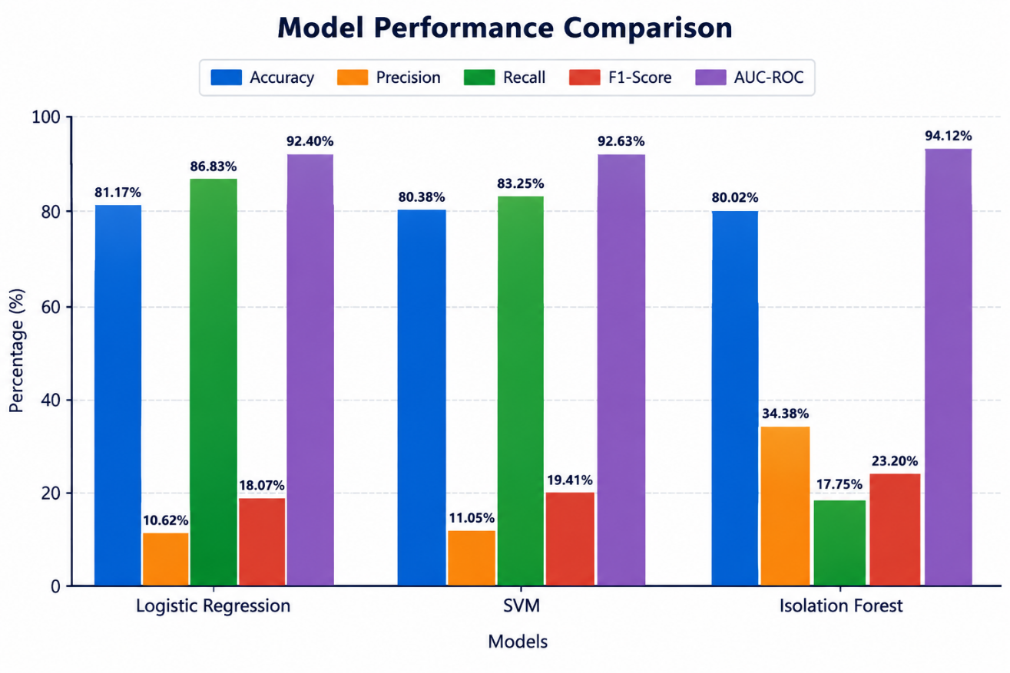
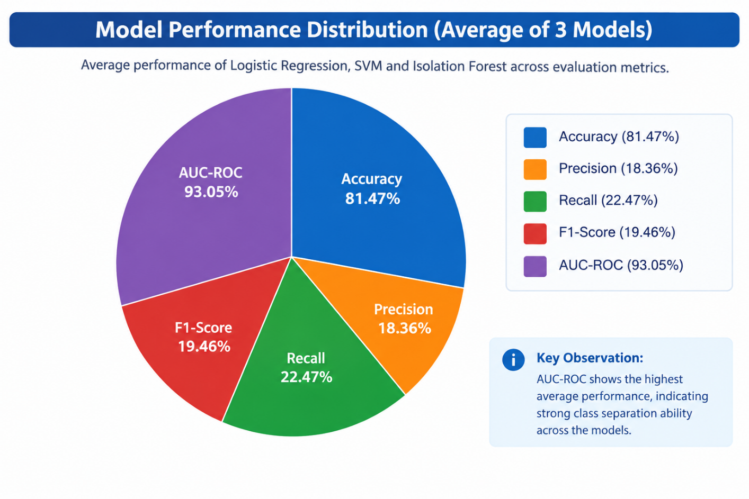
RESULTS - GRAPHS

Slide 16
DISCUSSION
The performance of the three models differs because they use different approaches to fraud detection. Logistic Regression and SVM are supervised classification algorithms that learn patterns from labeled transactions, while Isolation Forest focuses on identifying unusual or anomalous transactions. The results also show that fraud detection involves a trade-off between Precision and Recall. Logistic Regression has higher Recall, whereas Isolation Forest has higher Precision. The relatively low F1-Scores are influenced by the highly imbalanced dataset, where fraudulent transactions represent only 1.70% of all transactions. Therefore, evaluating the models using multiple metrics such as Precision, Recall, F1-Score, and AUC-ROC provides a more meaningful understanding of their performance than Accuracy alone.

Slide 17
CONCLUSION
The project successfully developed a machine-learning-based credit card fraud detection system for identifying suspicious transactions. Logistic Regression, Support Vector Machine (SVM), and Isolation Forest were implemented and evaluated. The dataset contained 20,000 transactions, with 339 fraudulent transactions (1.70%), showing a highly imbalanced fraud-detection problem. Exploratory Data Analysis (EDA) was performed to understand transaction patterns and relationships among important features. The models were evaluated using Accuracy, Precision, Recall, F1-Score, and AUC-ROC. The results show different performance characteristics among the three models. Isolation Forest achieved the highest AUC-ROC (94.12%) and Precision (34.38%), while Logistic Regression achieved the highest Recall (86.83%) among the tested models. The developed system can classify a transaction as SAFE or FRAUD and provides a foundation for automated transaction monitoring.

Slide 18
FUTURE SCOPE
In the future, the proposed credit card fraud detection system can be enhanced by incorporating advanced machine learning and deep learning algorithms for improved fraud detection. The system can be extended to support real-time transaction monitoring, allowing suspicious transactions to be identified immediately. Additional behavioral features such as transaction frequency, location, device usage, and spending patterns can be incorporated to improve prediction. Techniques for handling imbalanced datasets can also be applied to improve precision and recall. Furthermore, the system can be integrated with real-time alerts, explainable AI, continuous model learning, and cloud deployment to provide a scalable and intelligent fraud detection solution.

Slide 19
THANK YOU

